Slide 1
April 2022
SC-OR INFLUENT PUMP STATION PROJECT

Slide 2
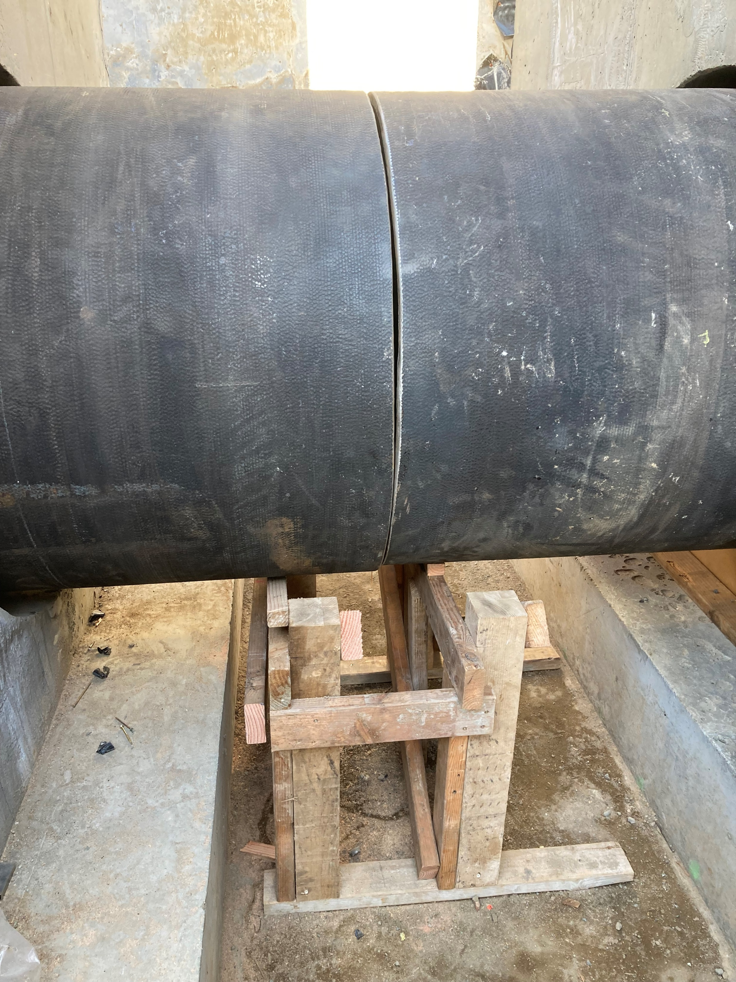
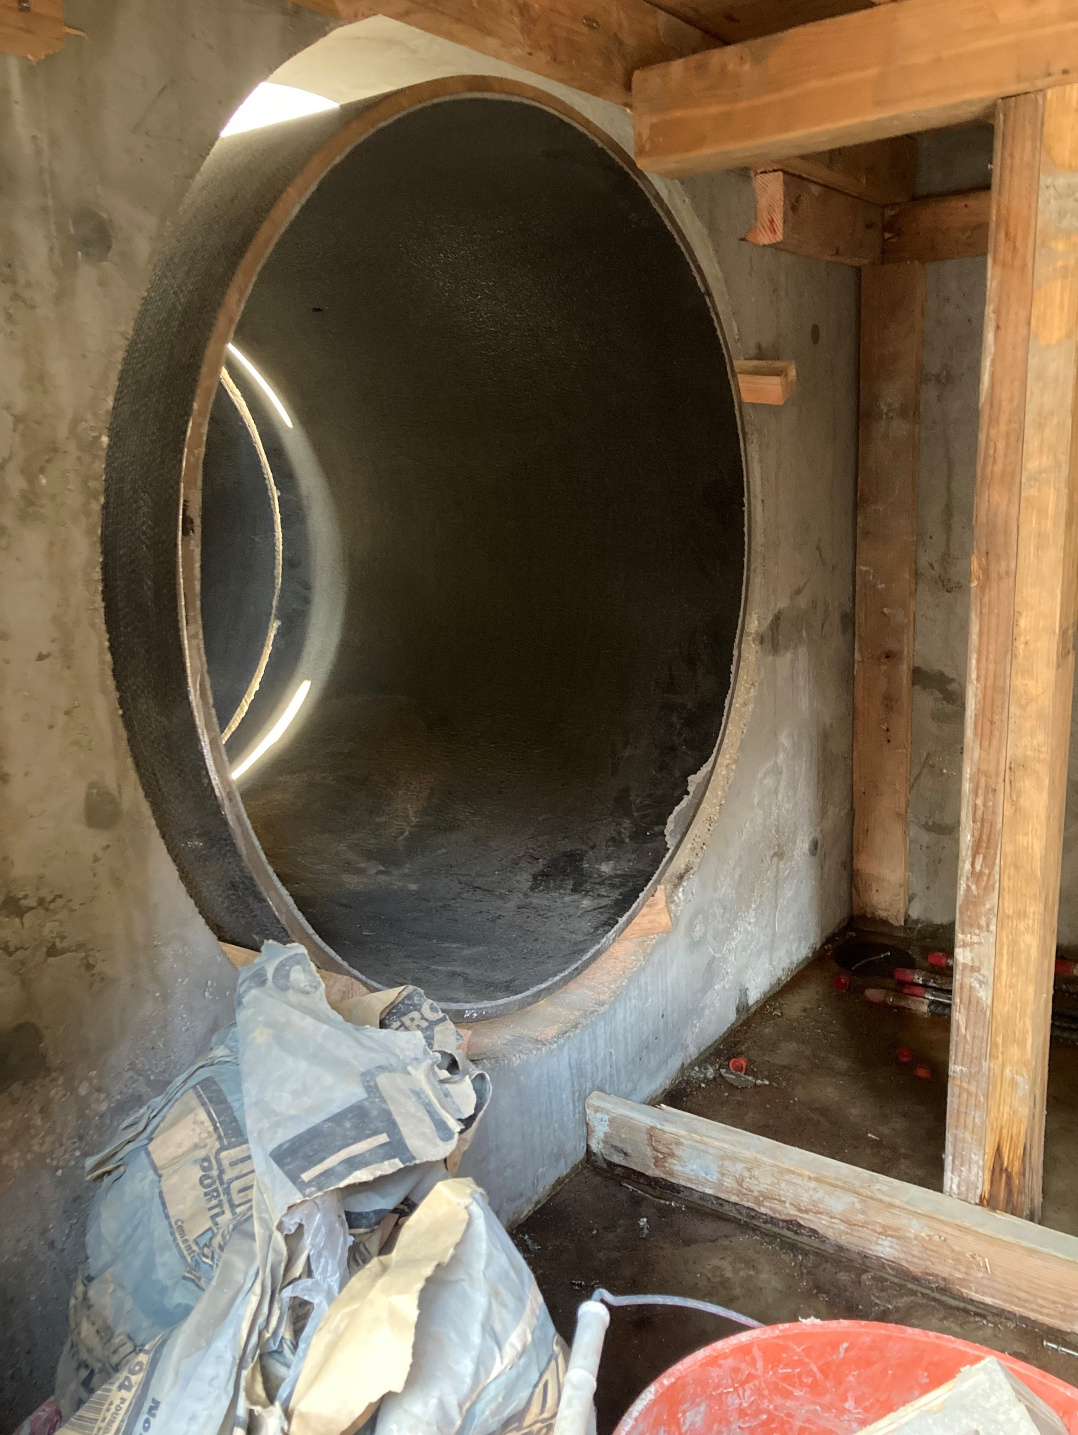
Pipe Work Being Installed

Slide 3
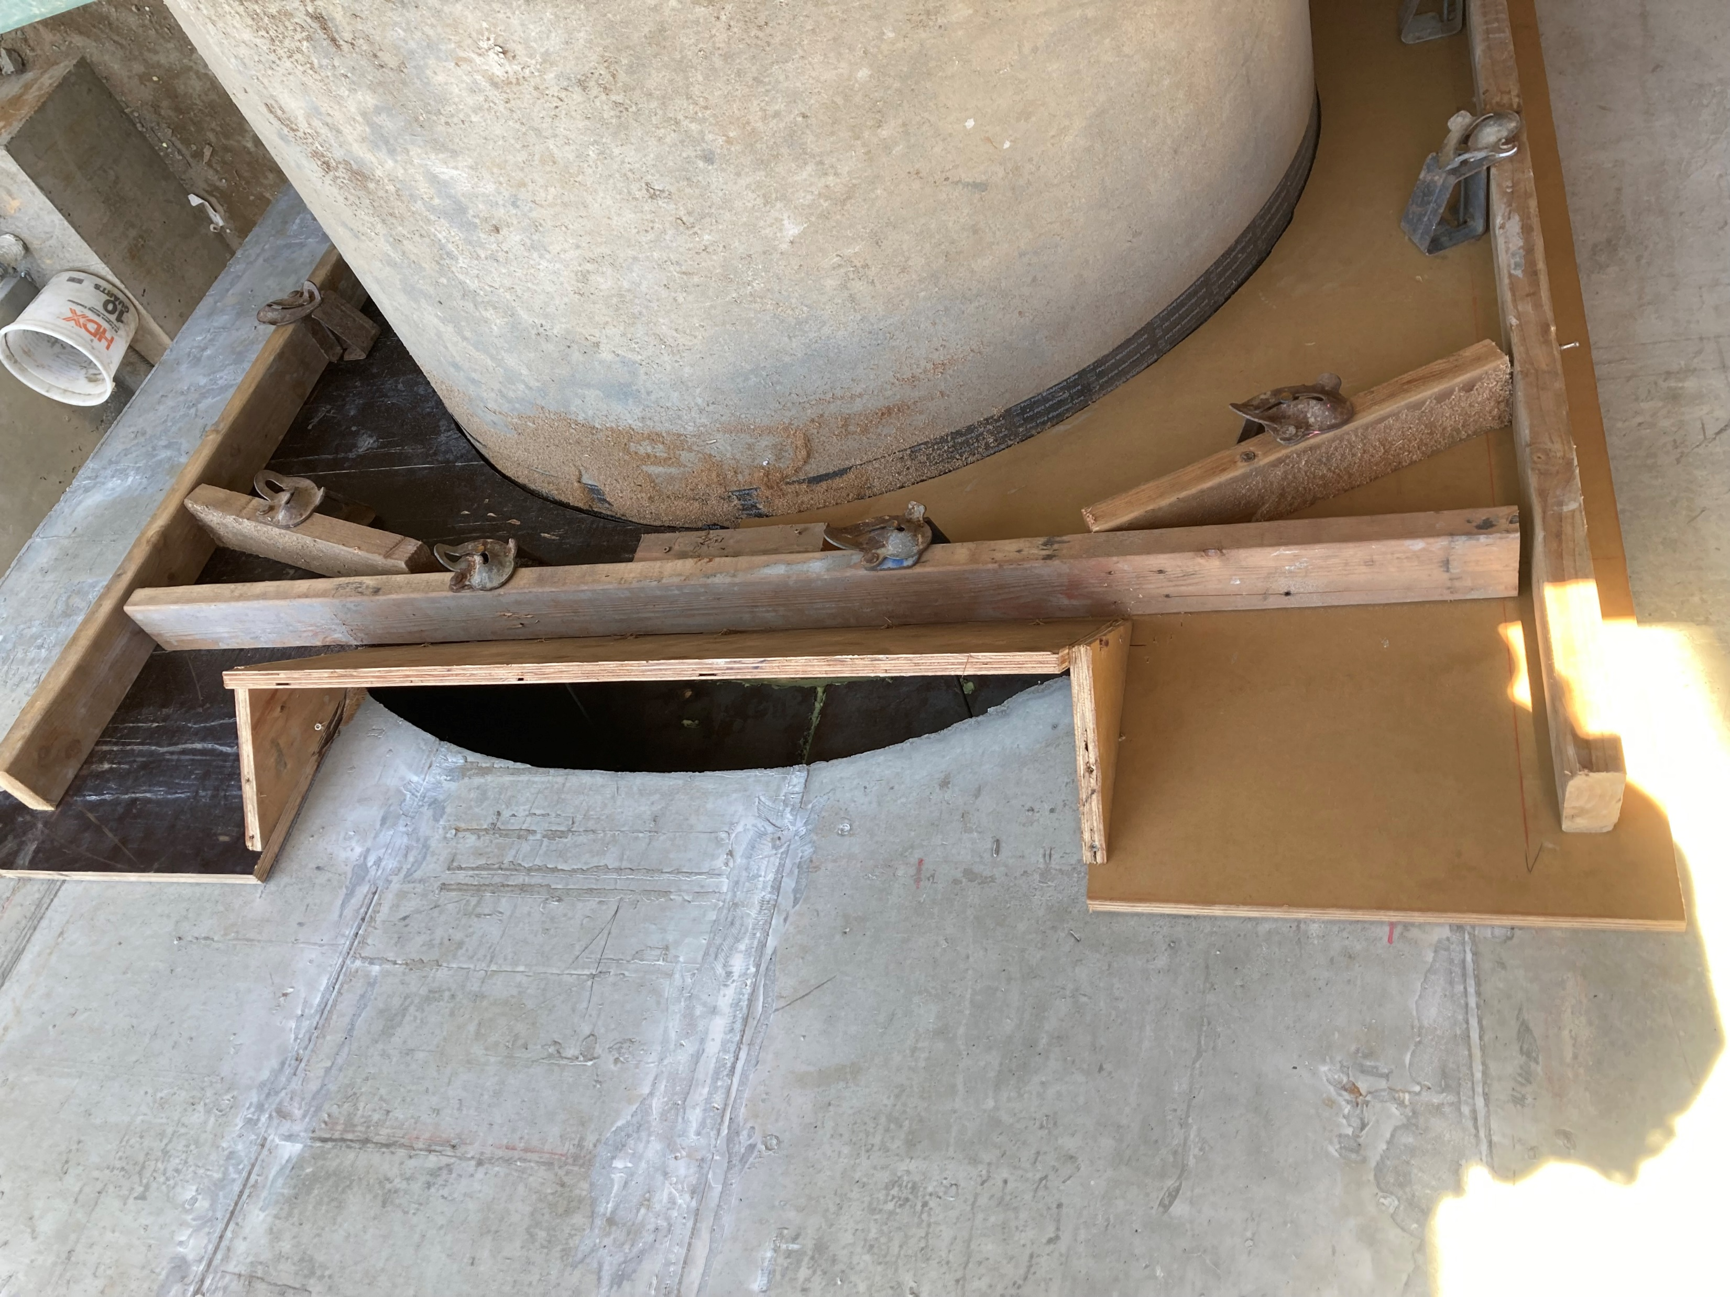
Forms at Pipe and Vault Joints

Slide 4
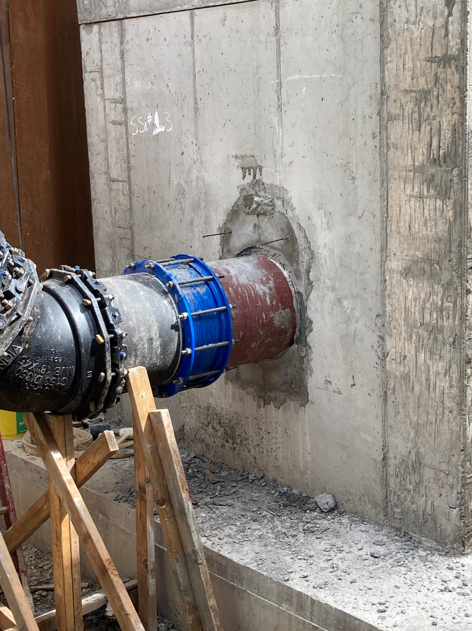
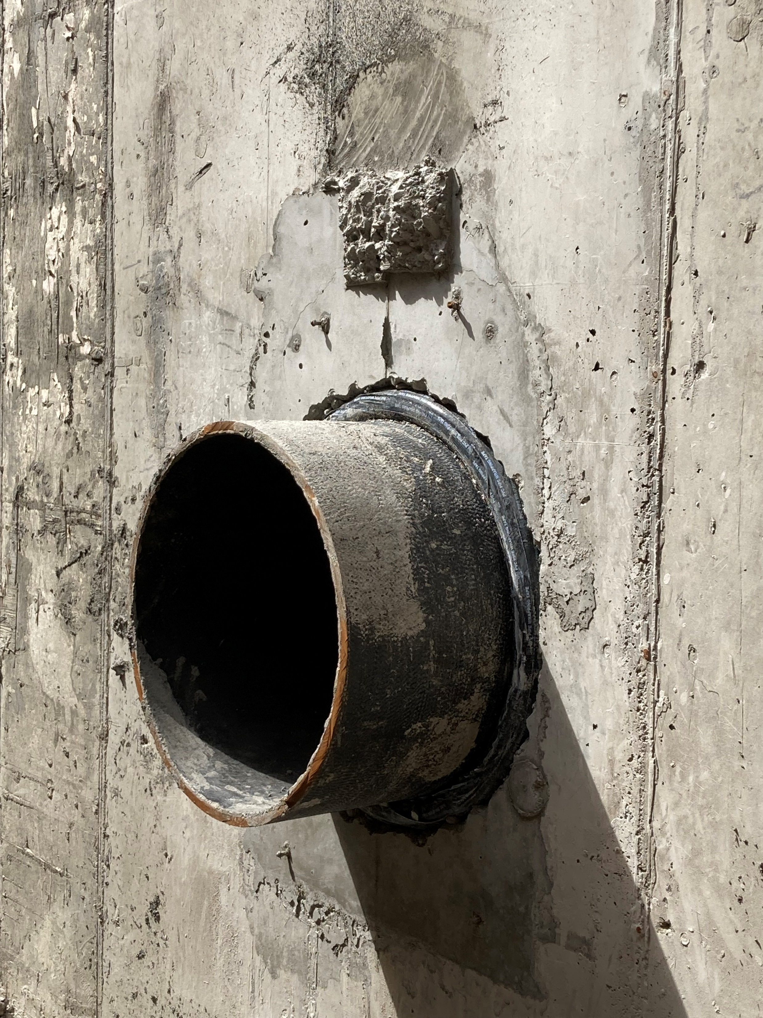
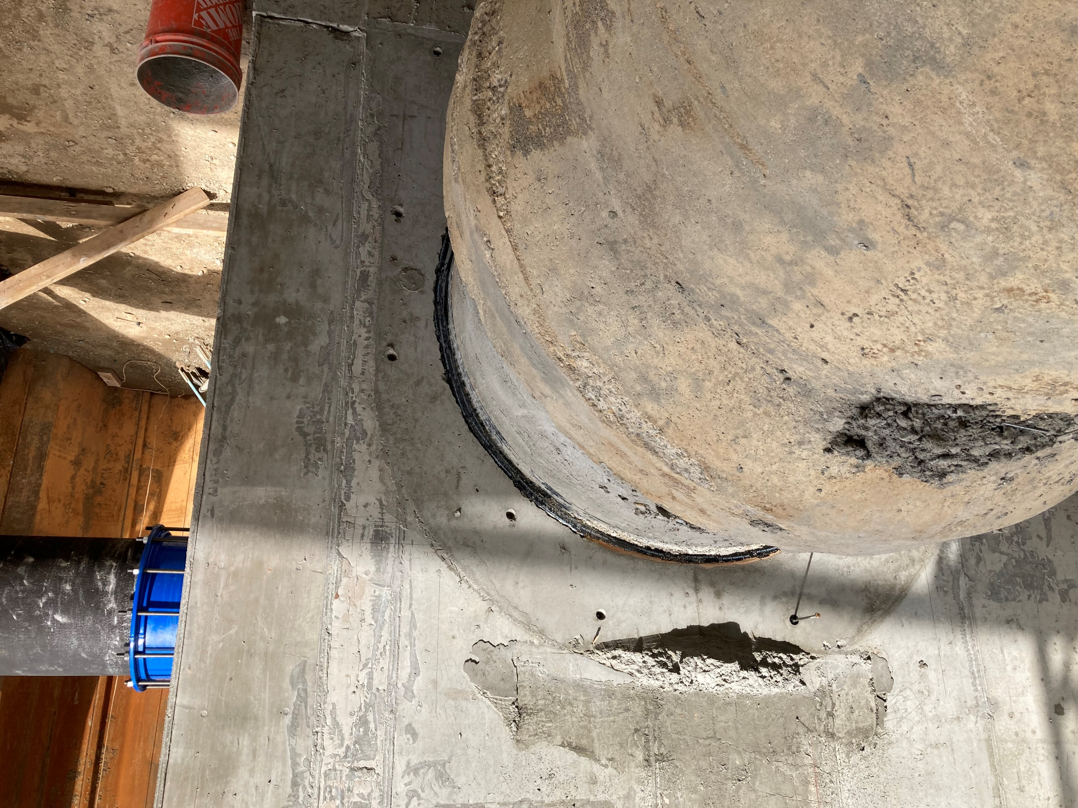
Pipe Joints Completed

Slide 5
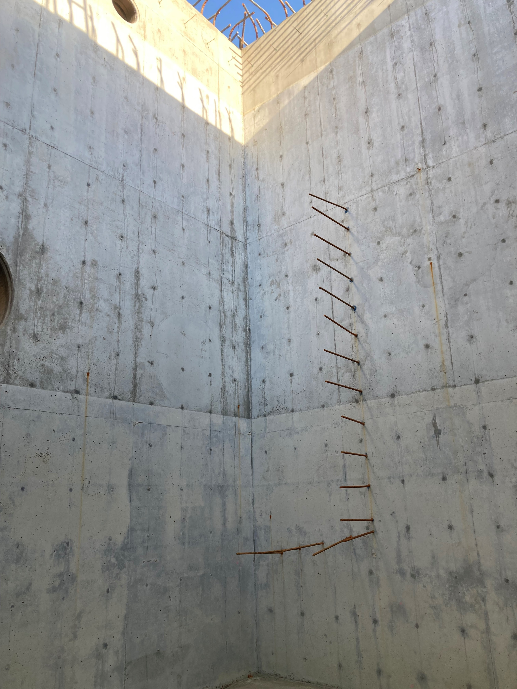
Rebar For Internal Wall In Wet Well

Slide 6
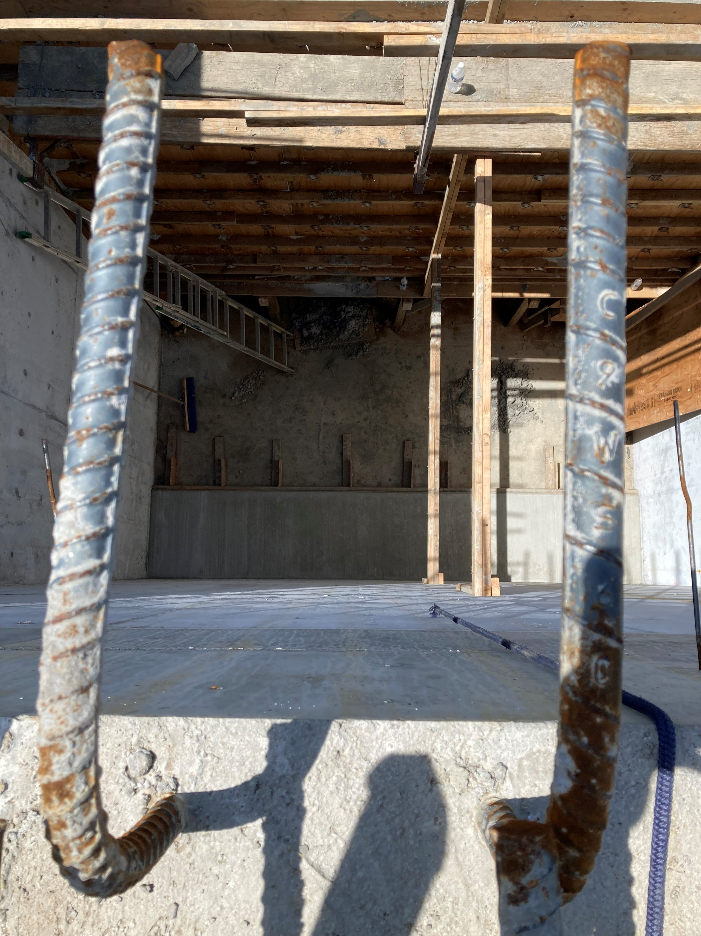
Internal Wet Well Wall Formed and Poured

