Slide 1
FEBRUARY 2022
SC-OR Influent Pump Station Project

Slide 2
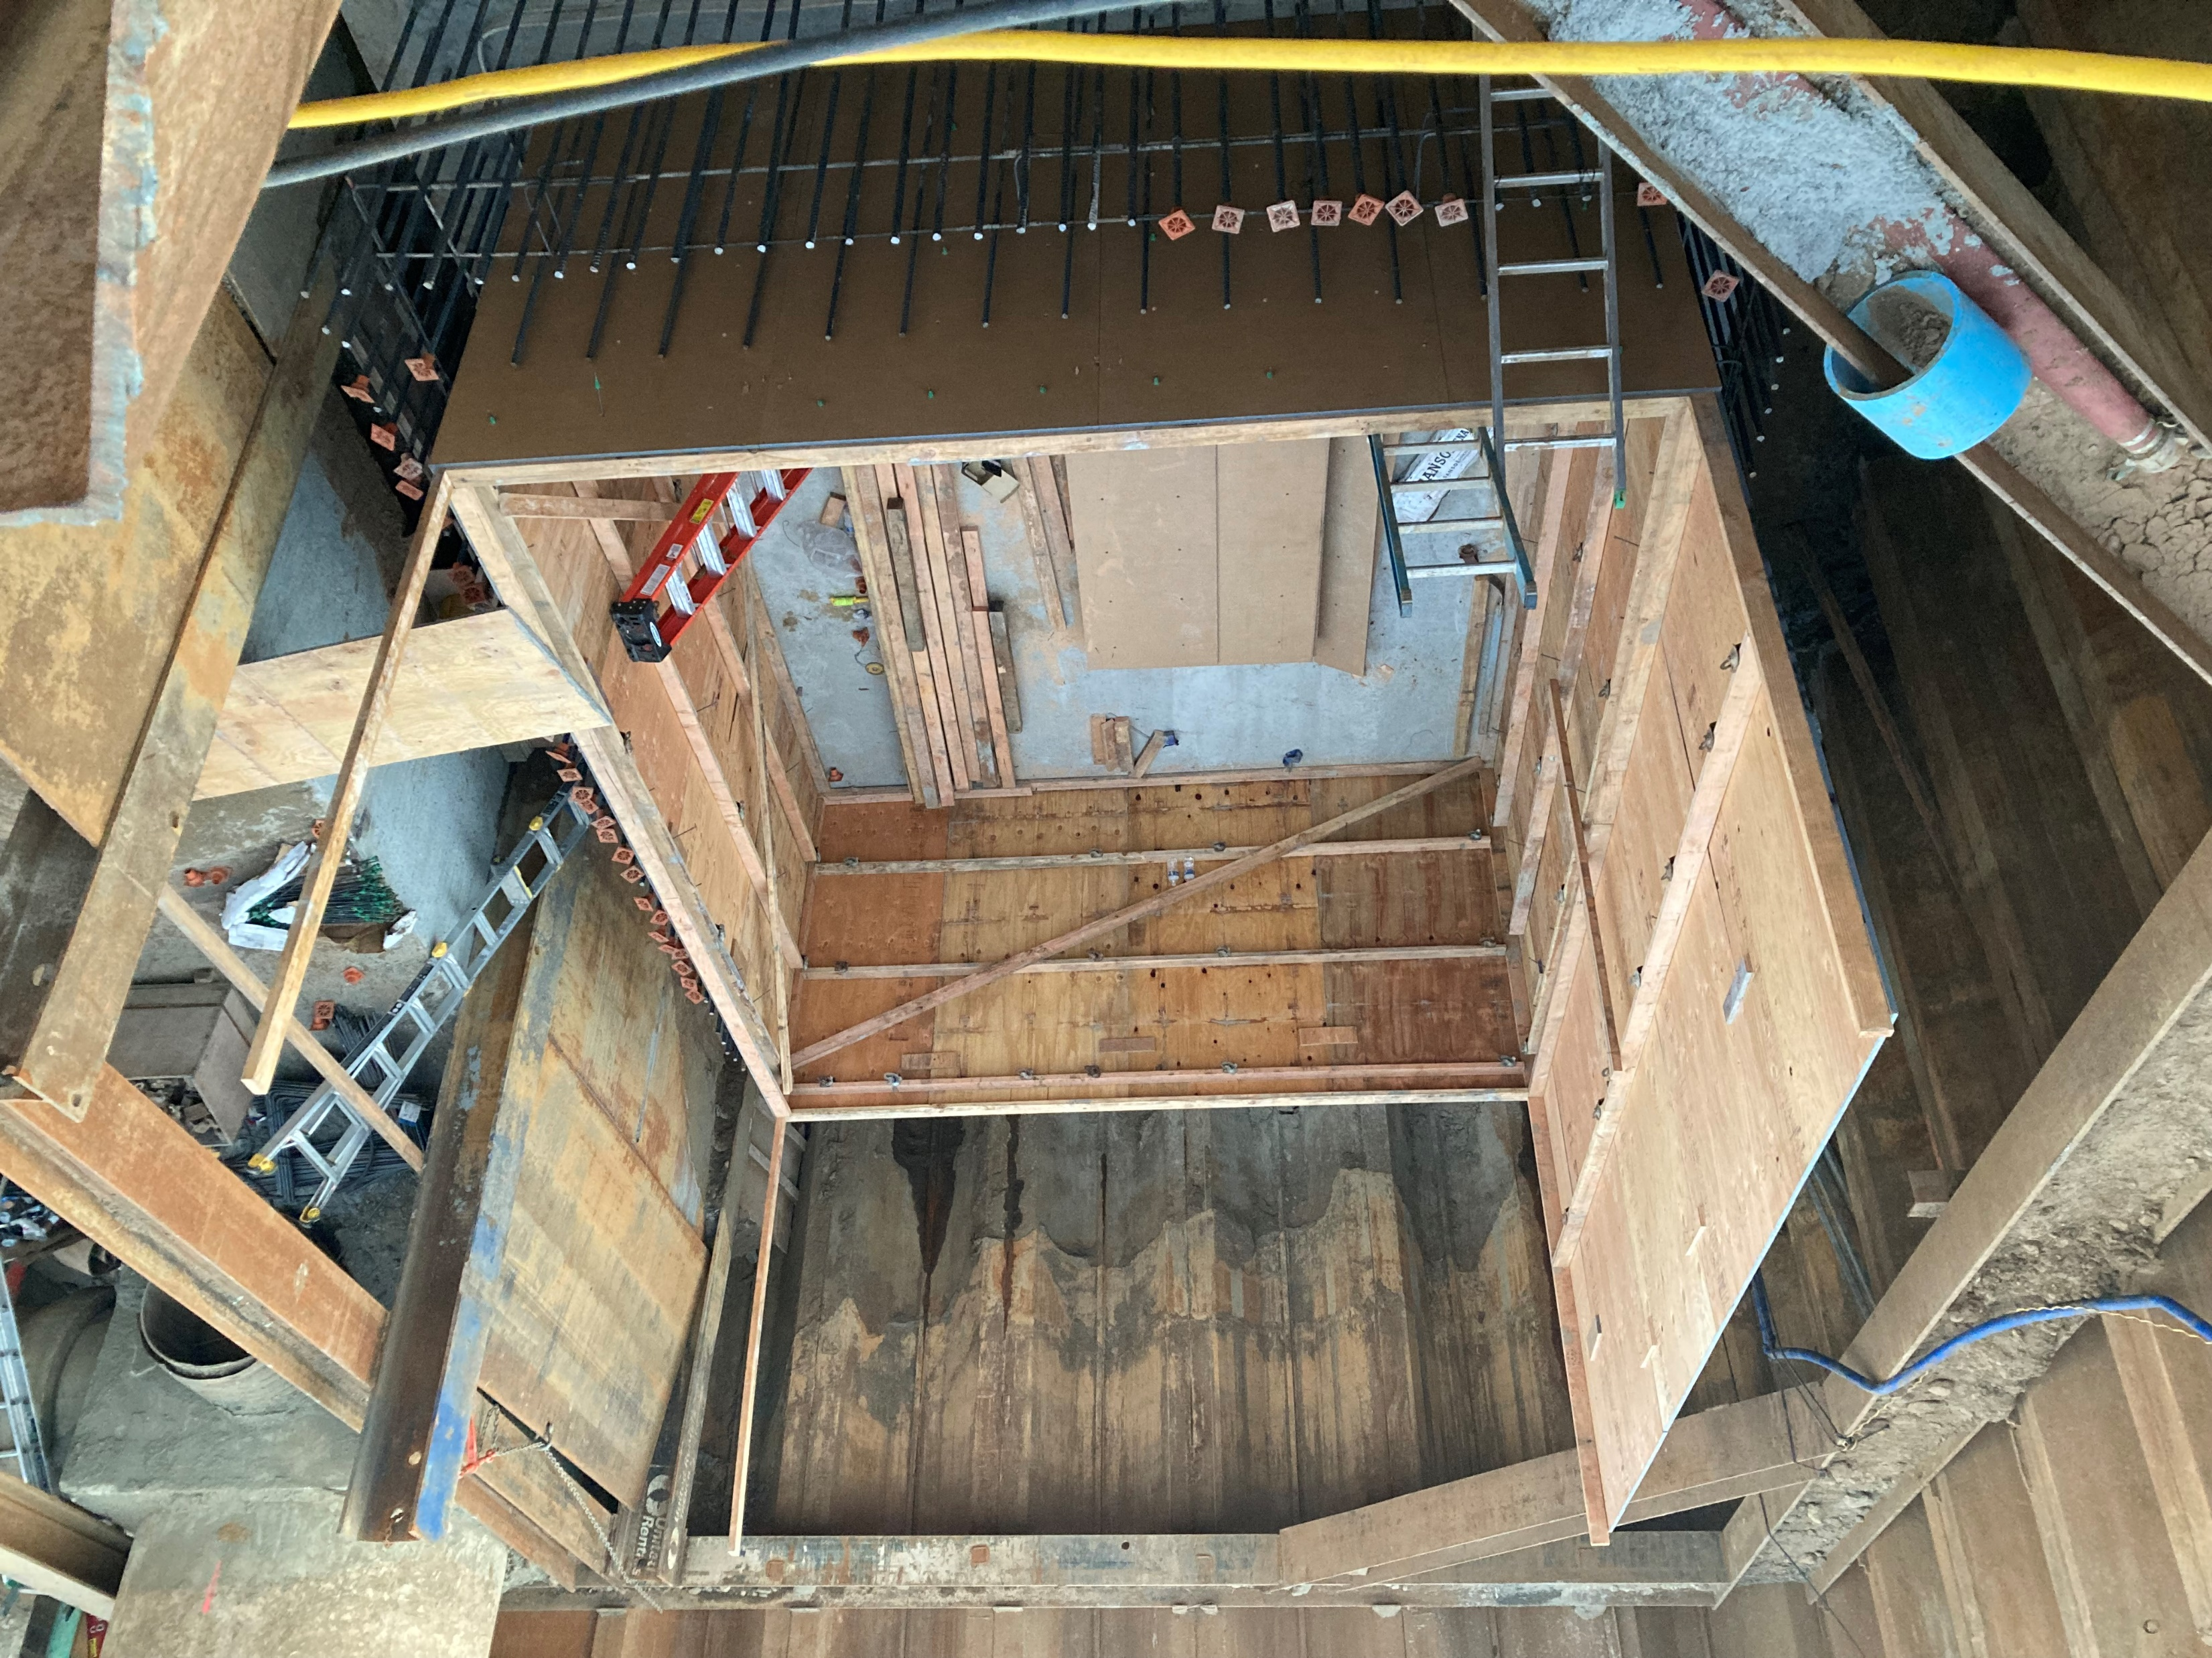
Construction of the Main Wet Well Begins

Slide 3
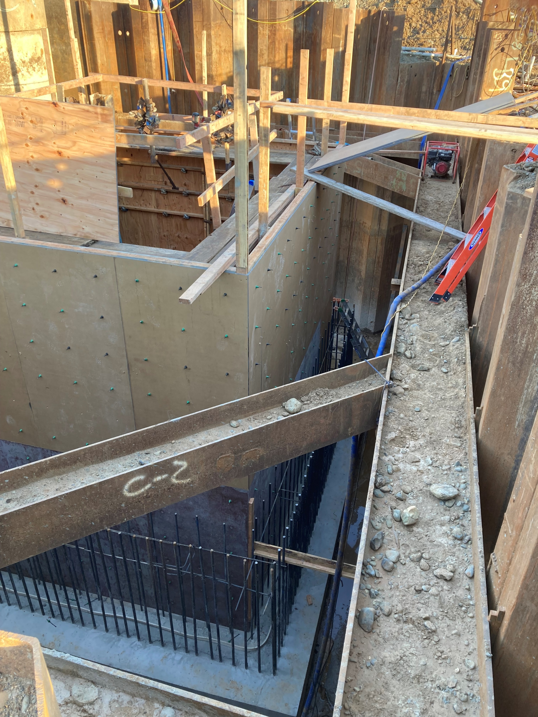
Interior Form Being Constructed

Slide 4
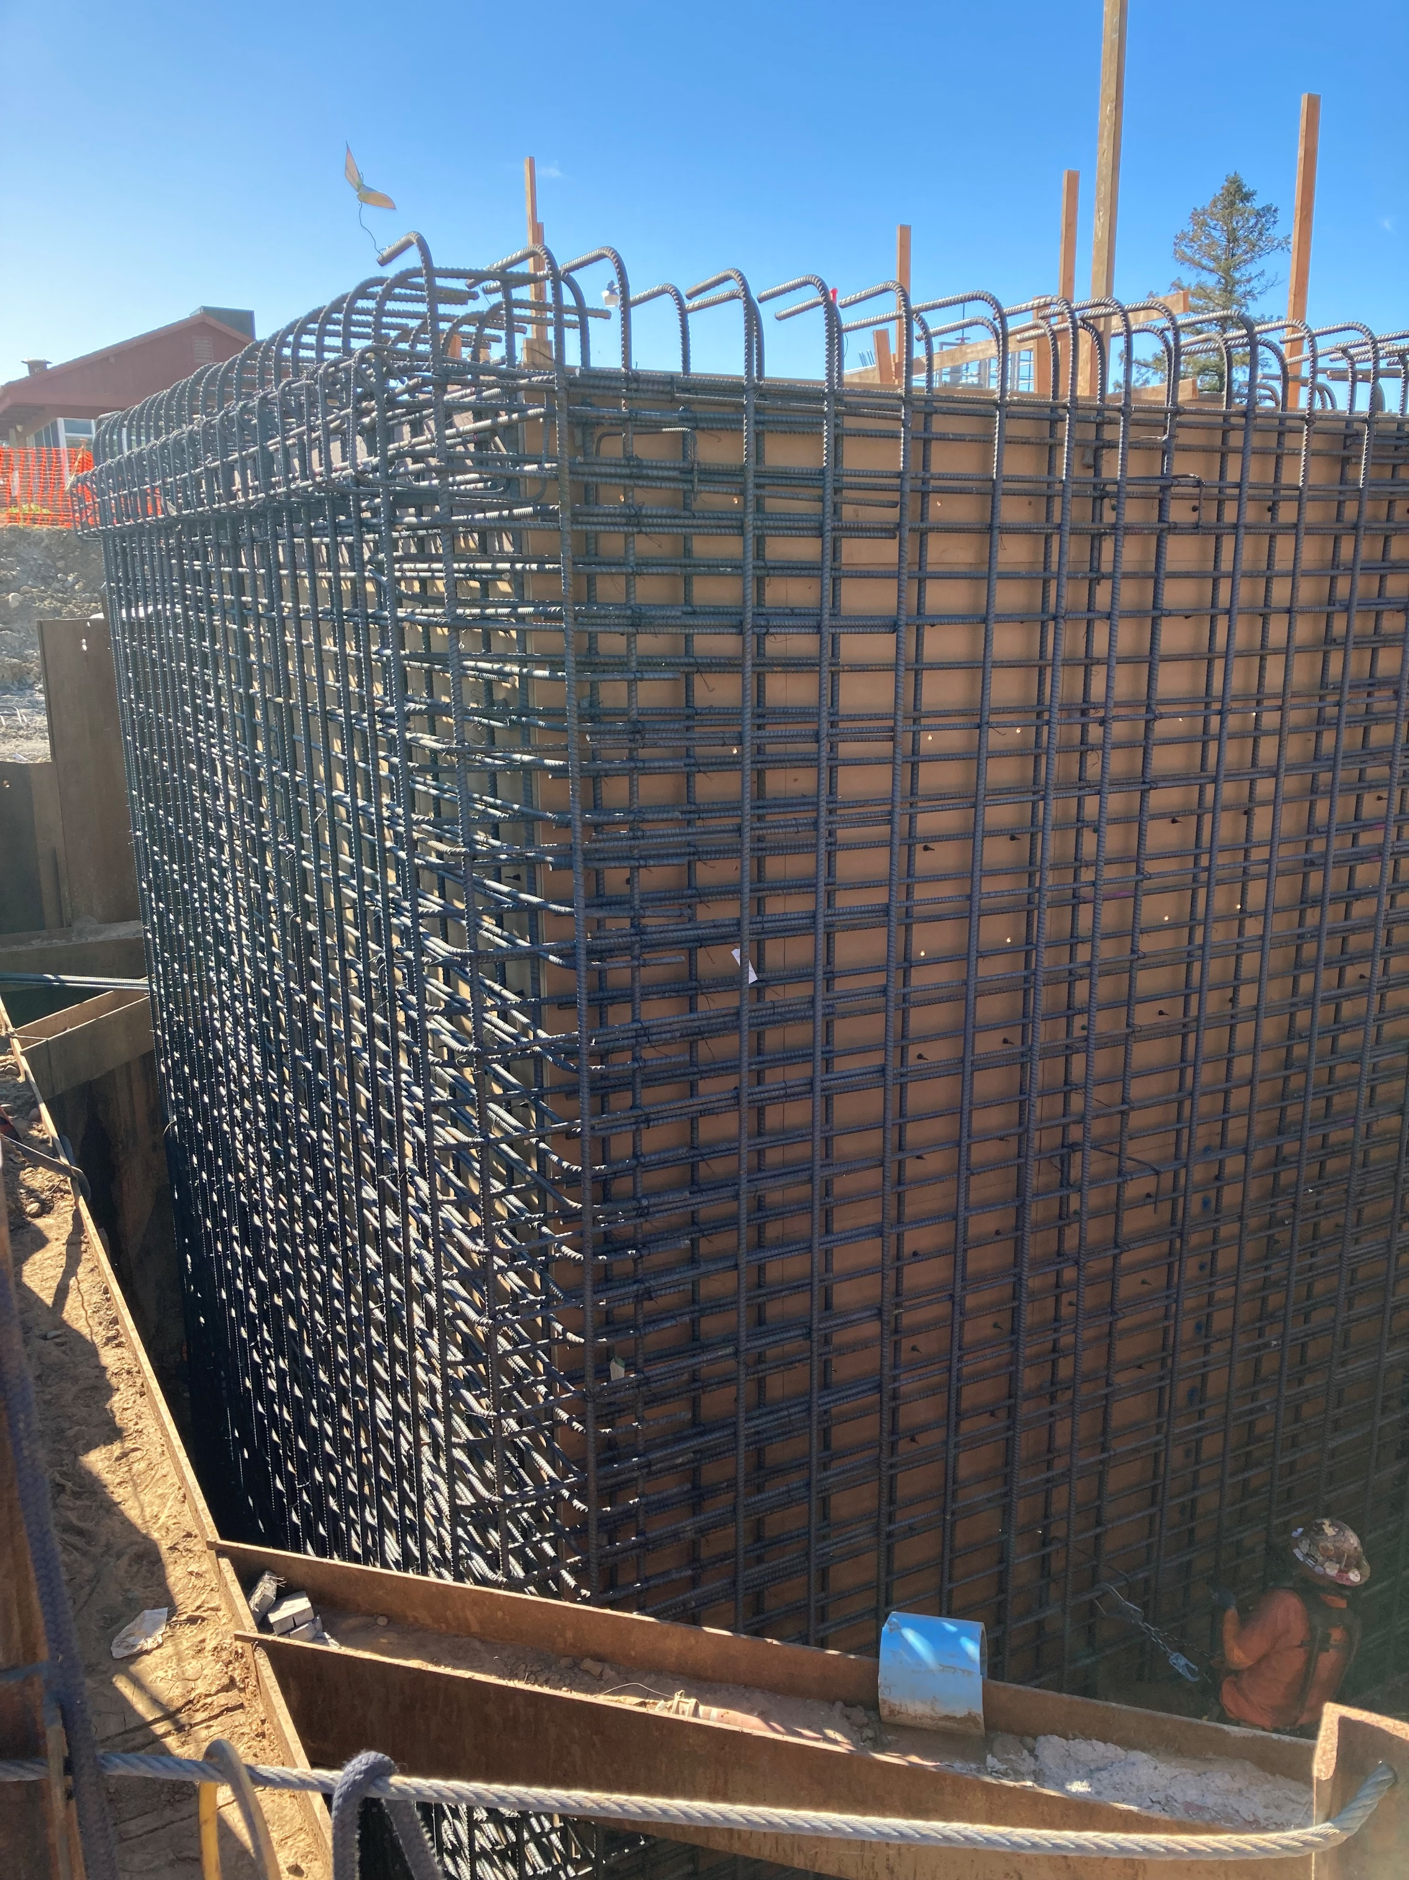
Interior Form and Rebar Complete

Slide 5
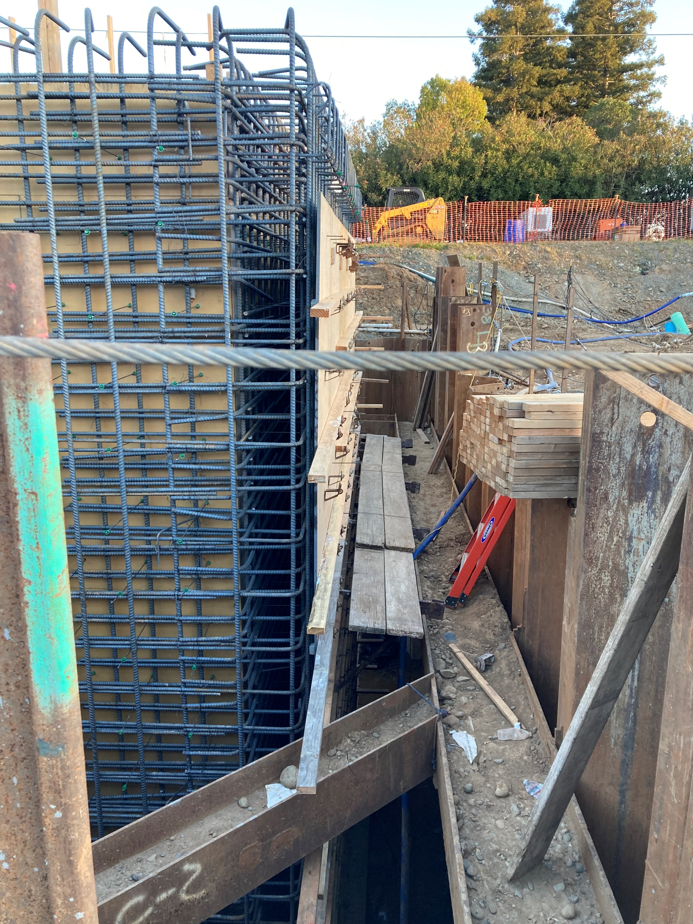
Exterior Form Being Constructed

Slide 6
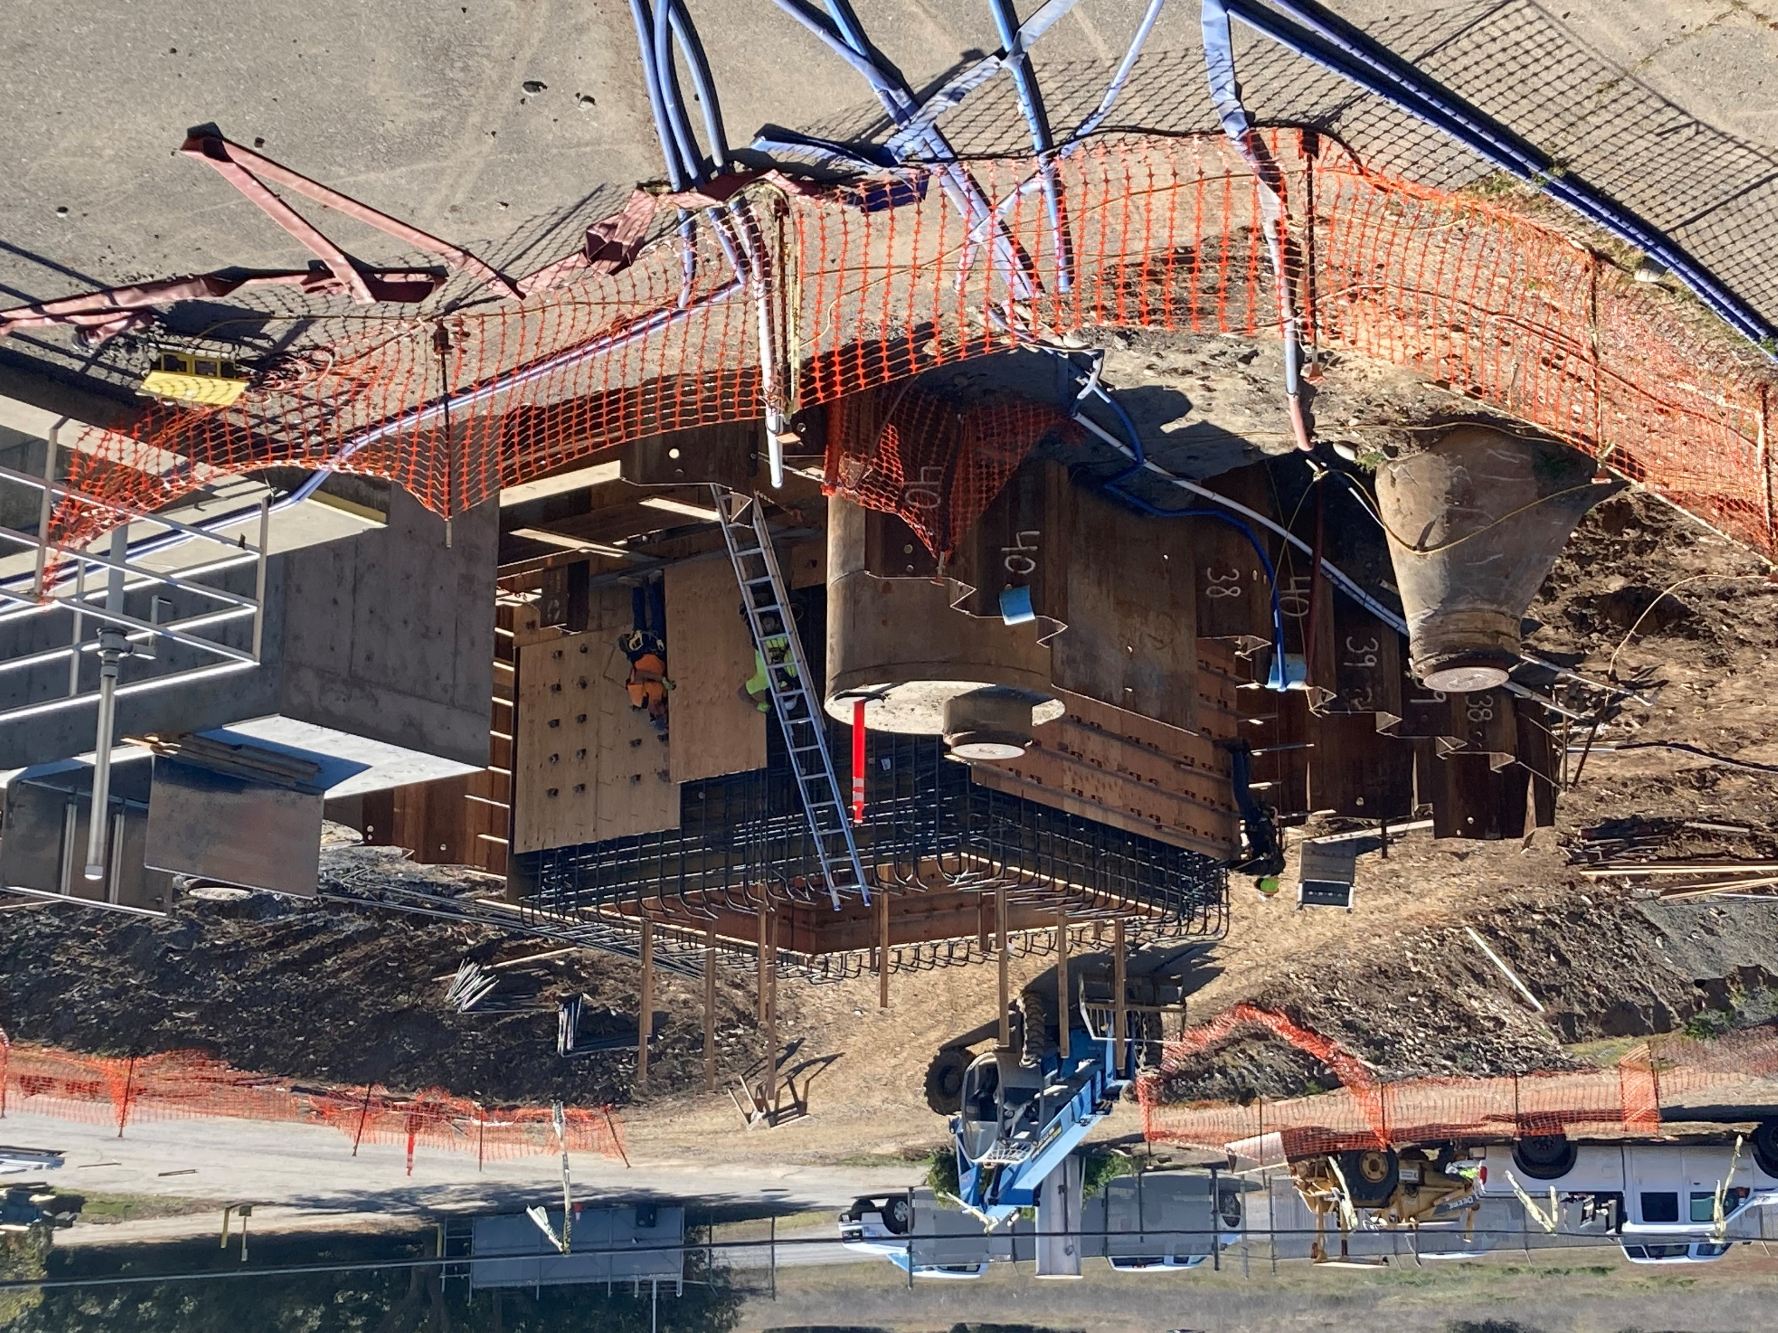
Exterior Forms of Wet Well Vault

Slide 7
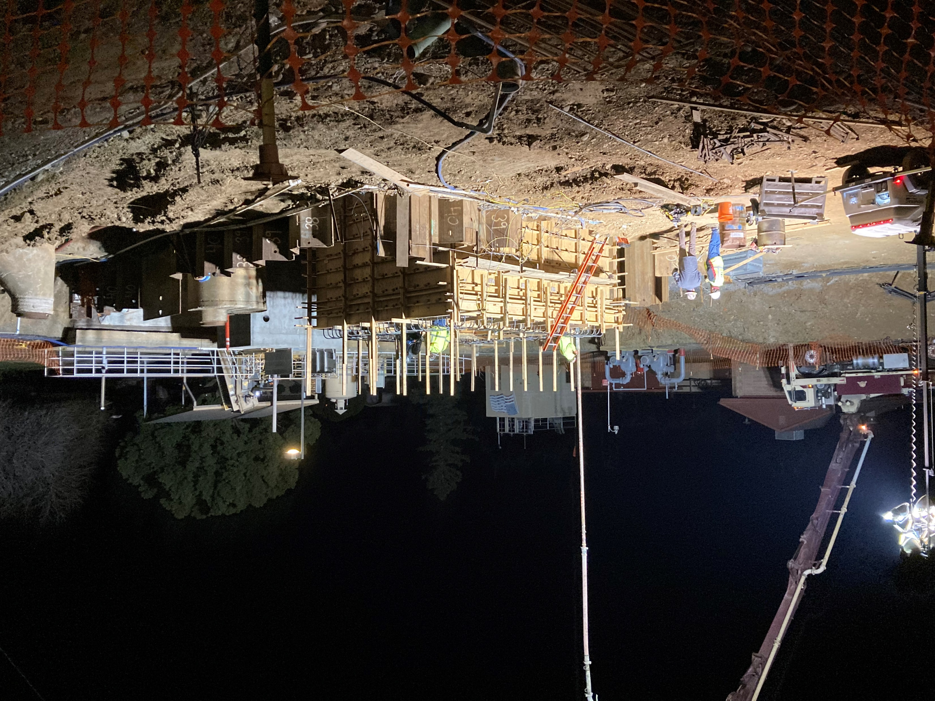
Pumping Concrete for the Wet Well Vault at 3a.m.

Slide 8
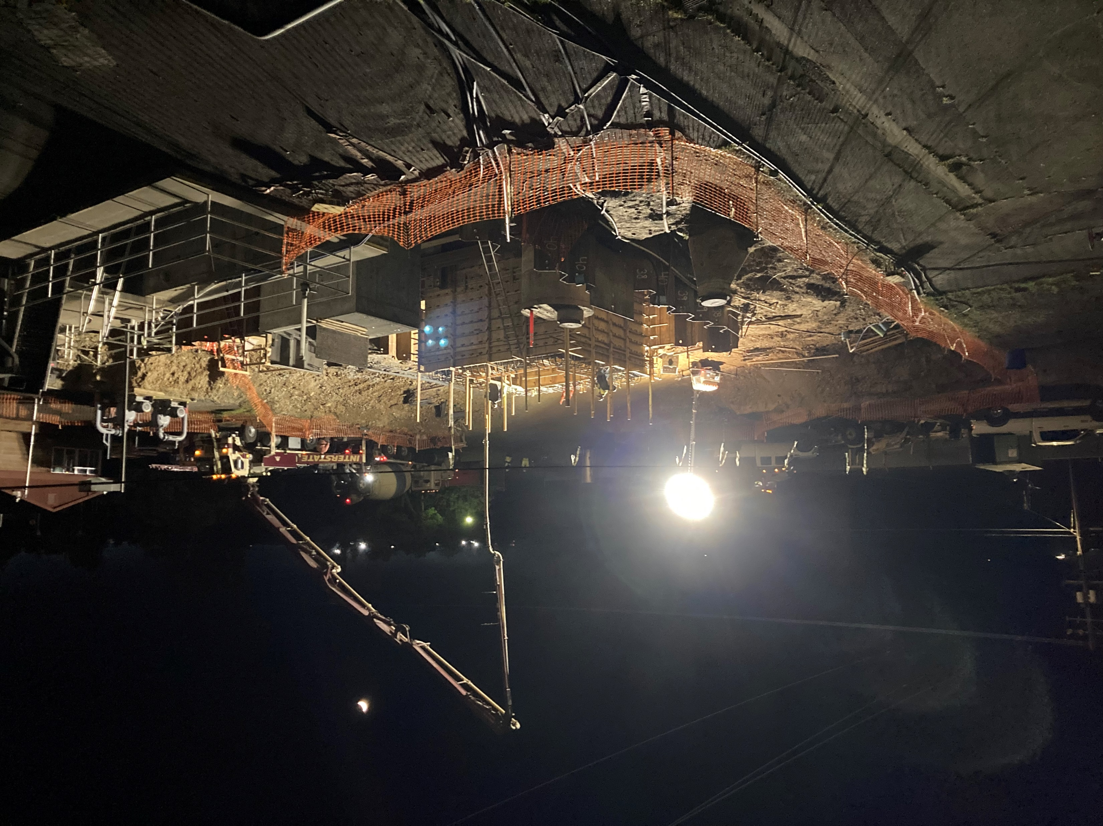
Night Pour: Concrete and Pumper Trucks in the Background

