Slide 1
May 2022
SC-OR INFLUENT PUMP STATION PROJECT

Slide 2
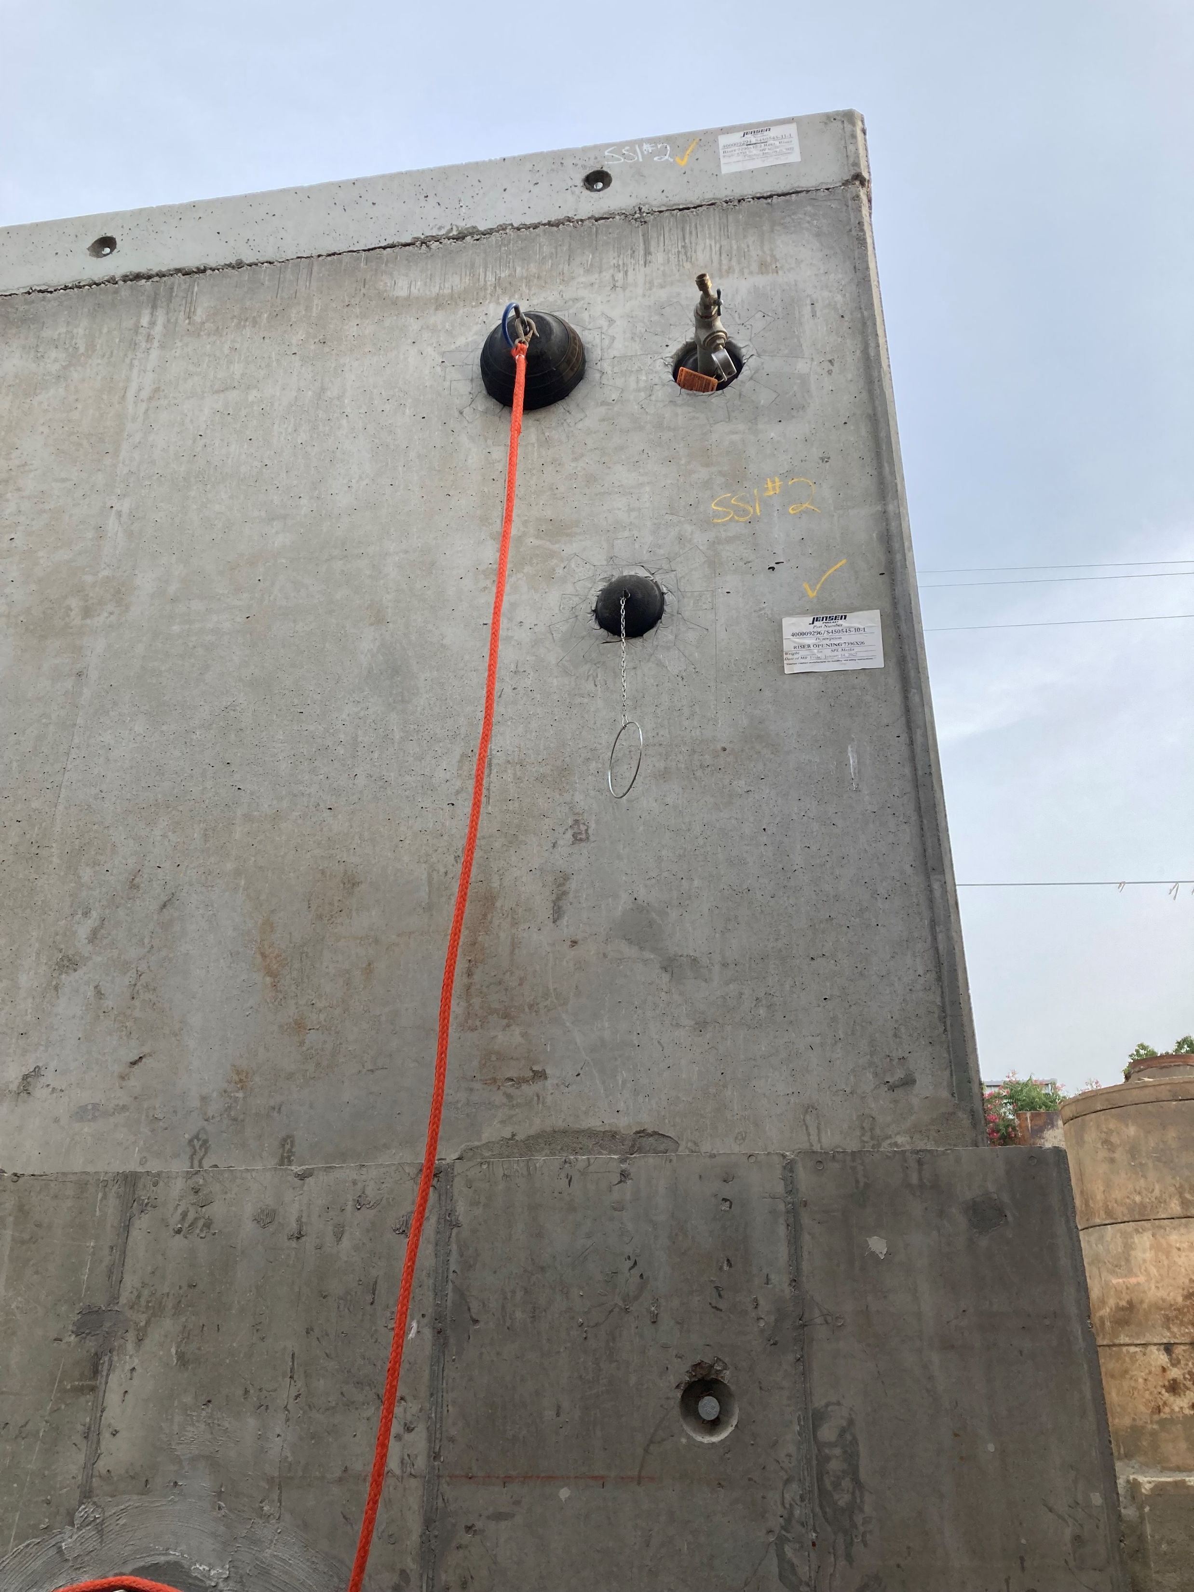
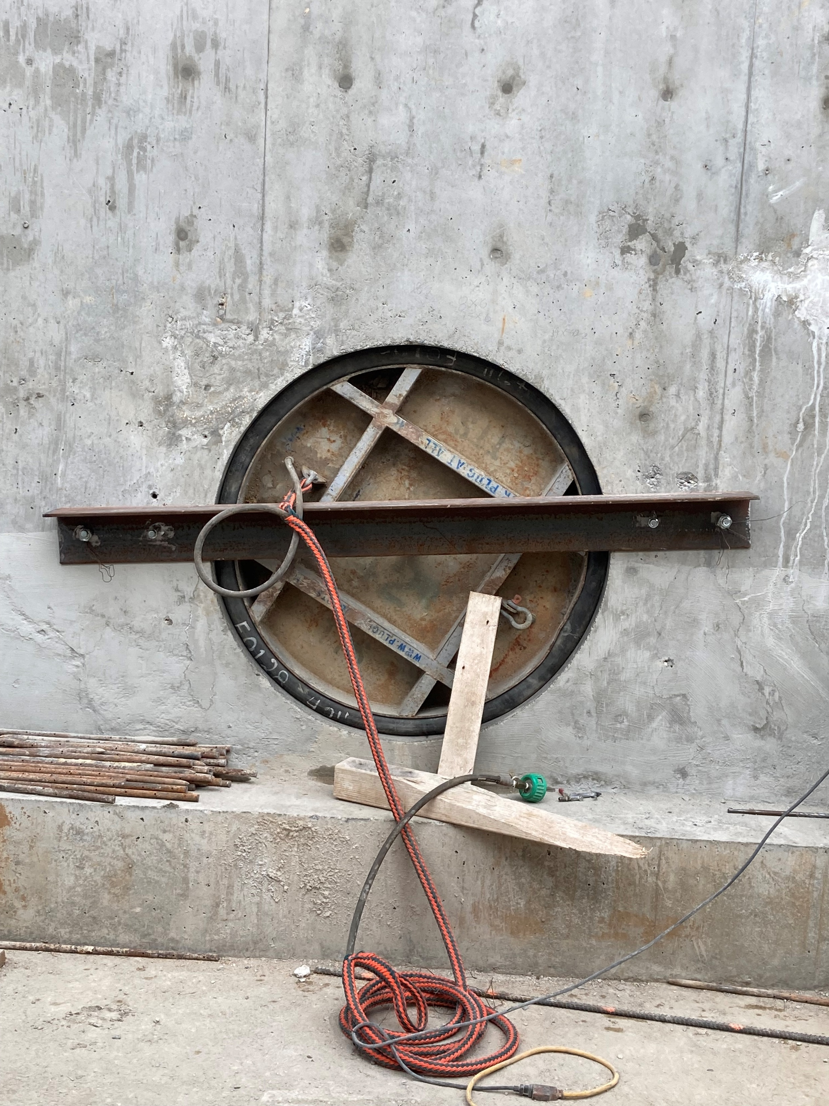
Plugging holes in vaults to test water tightness

Slide 3
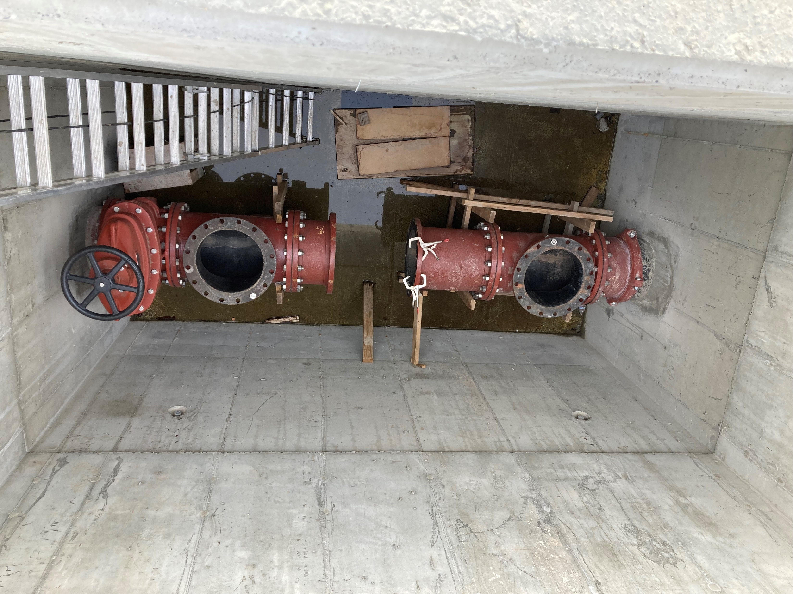
Pipe work in the flow meter vault

Slide 4
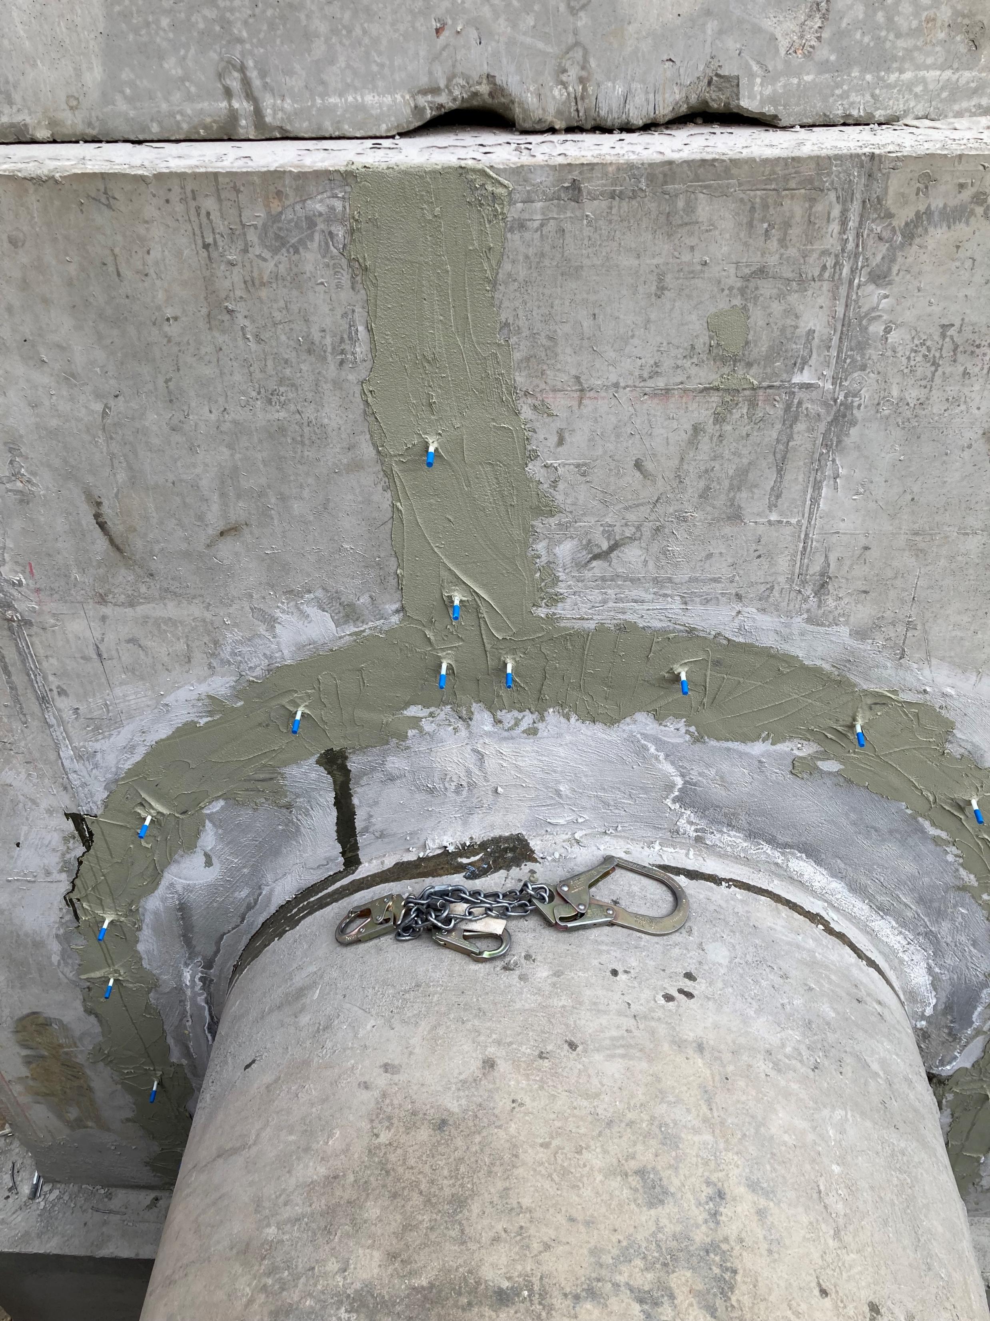
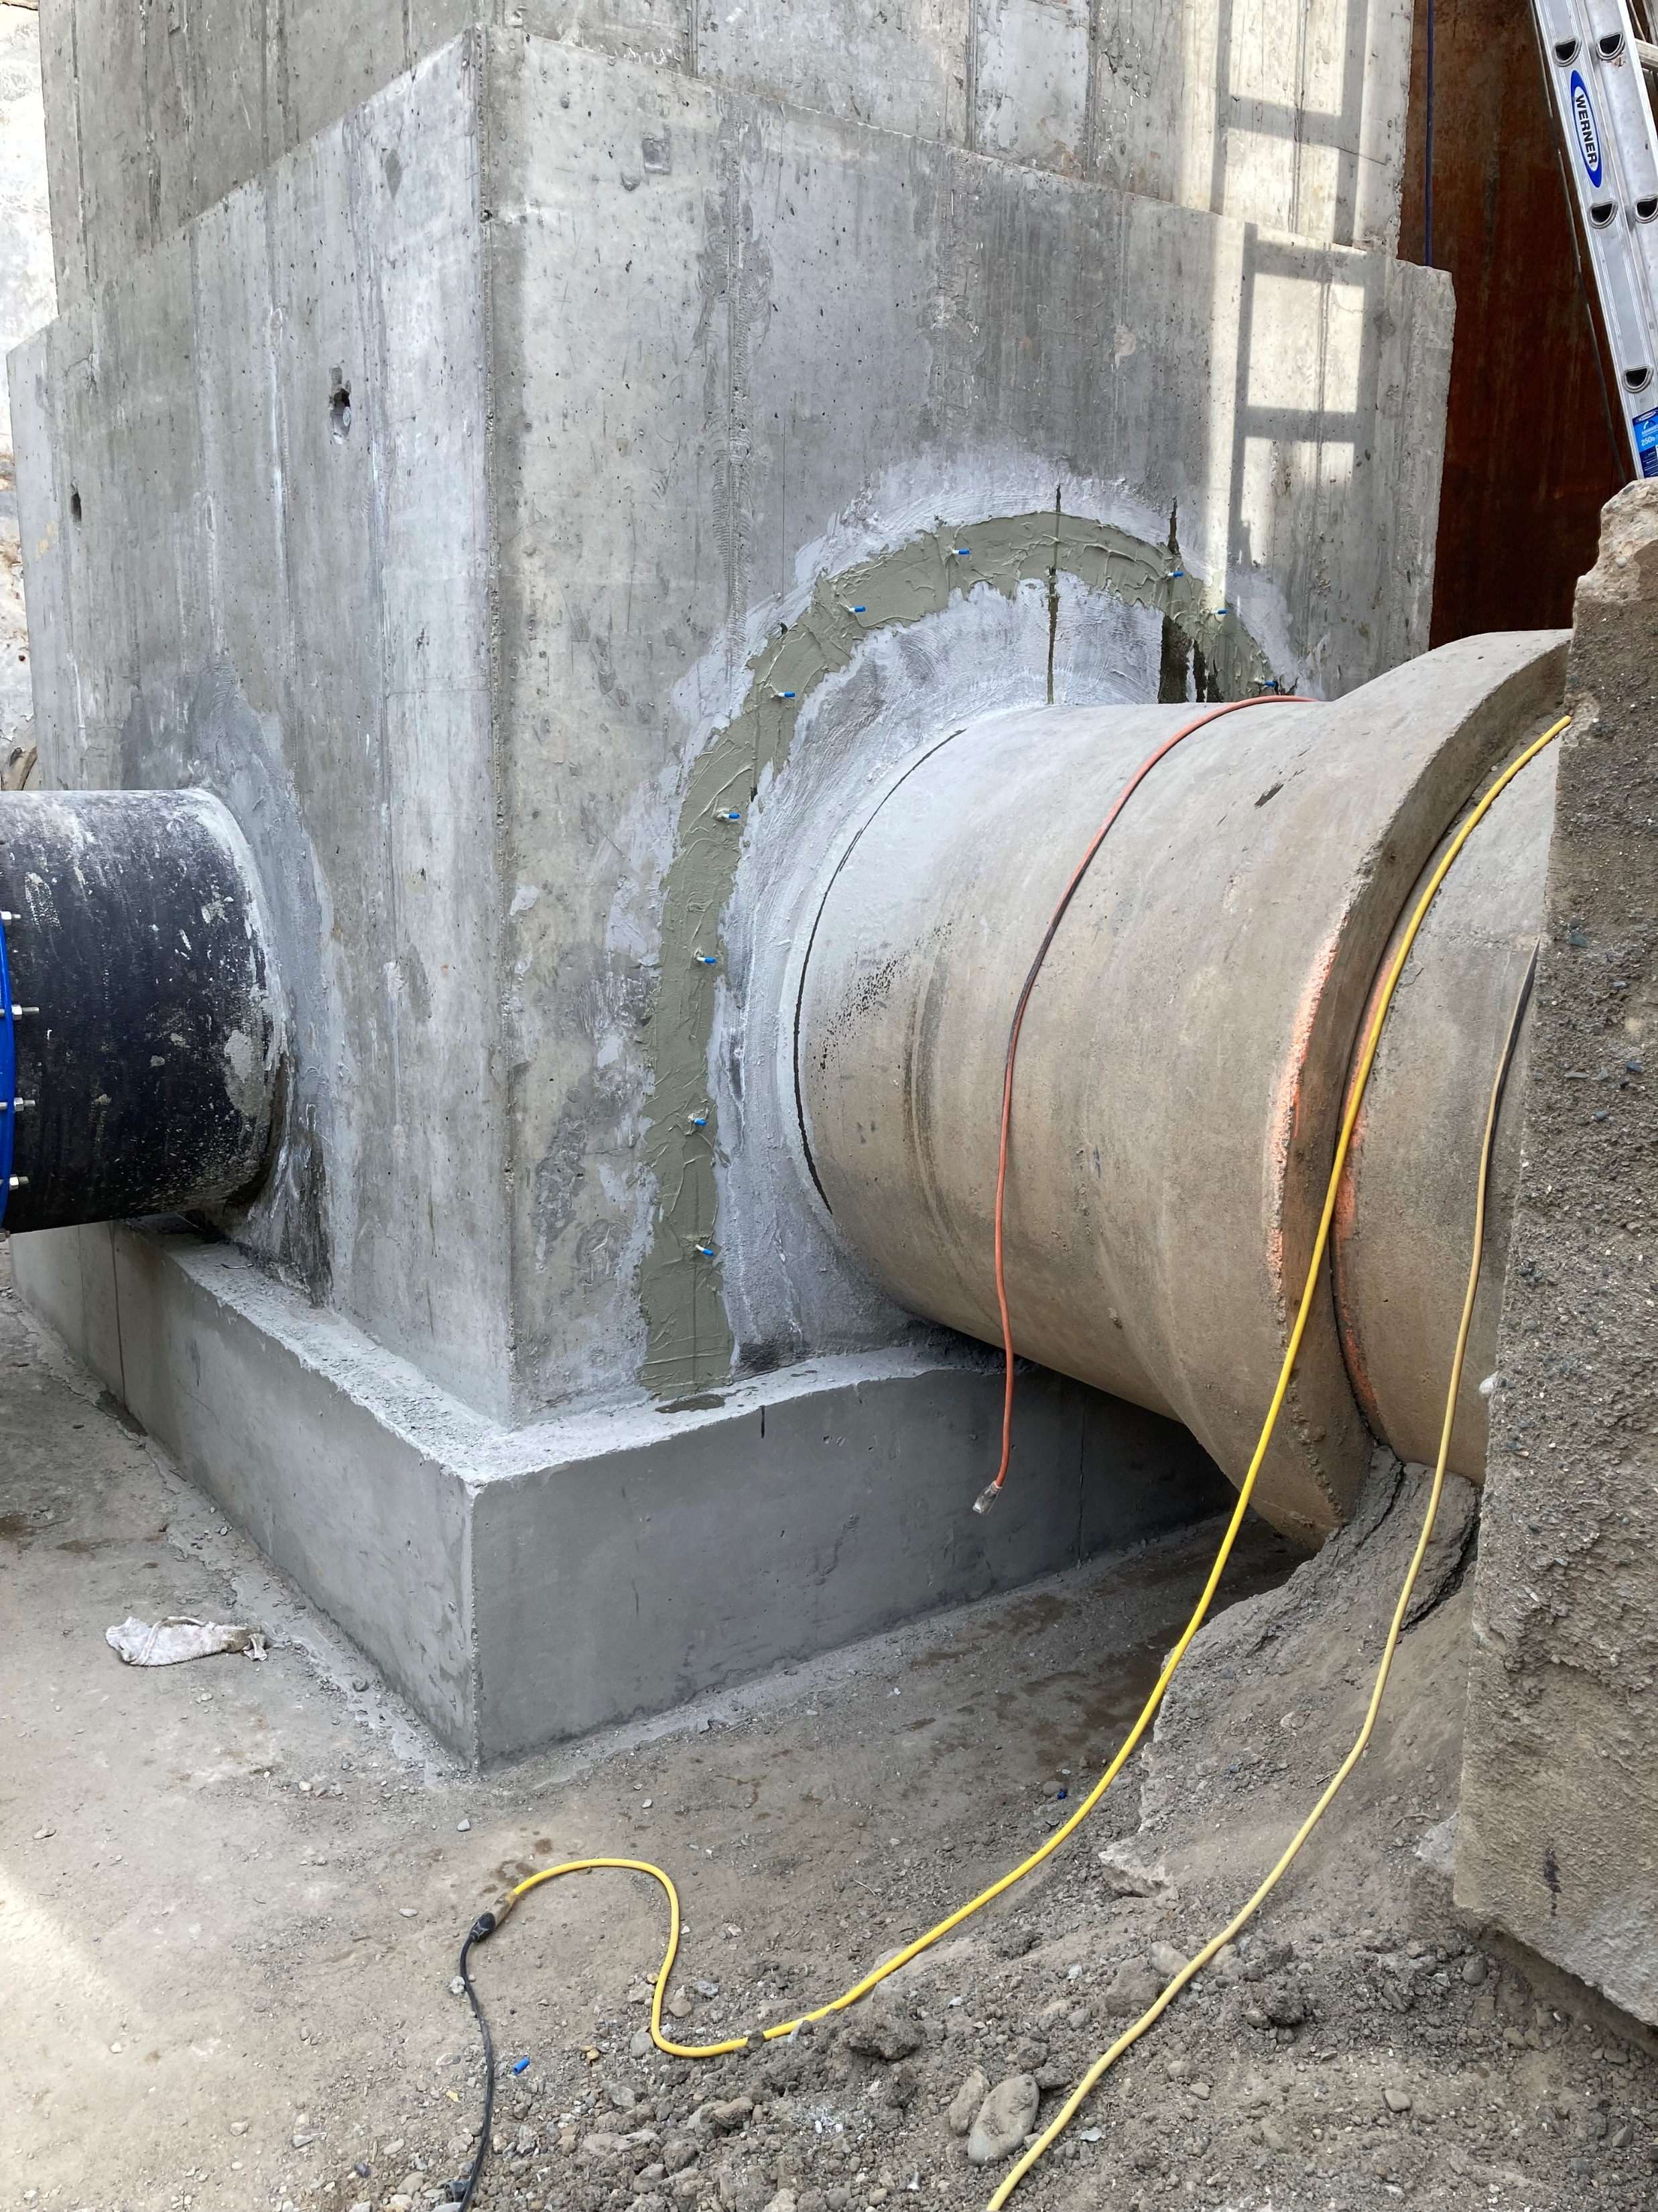
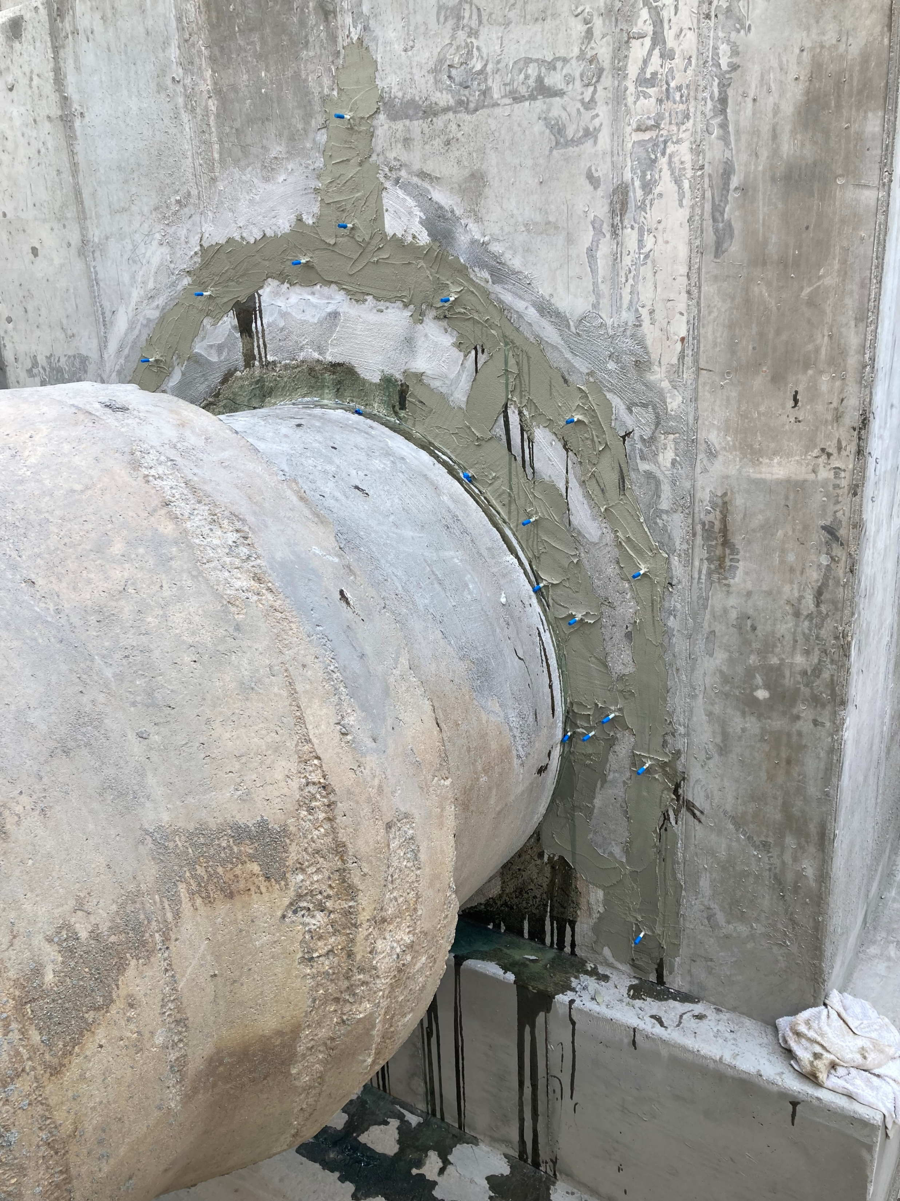
Epoxy Sealant Around Pipe Joints

Slide 5
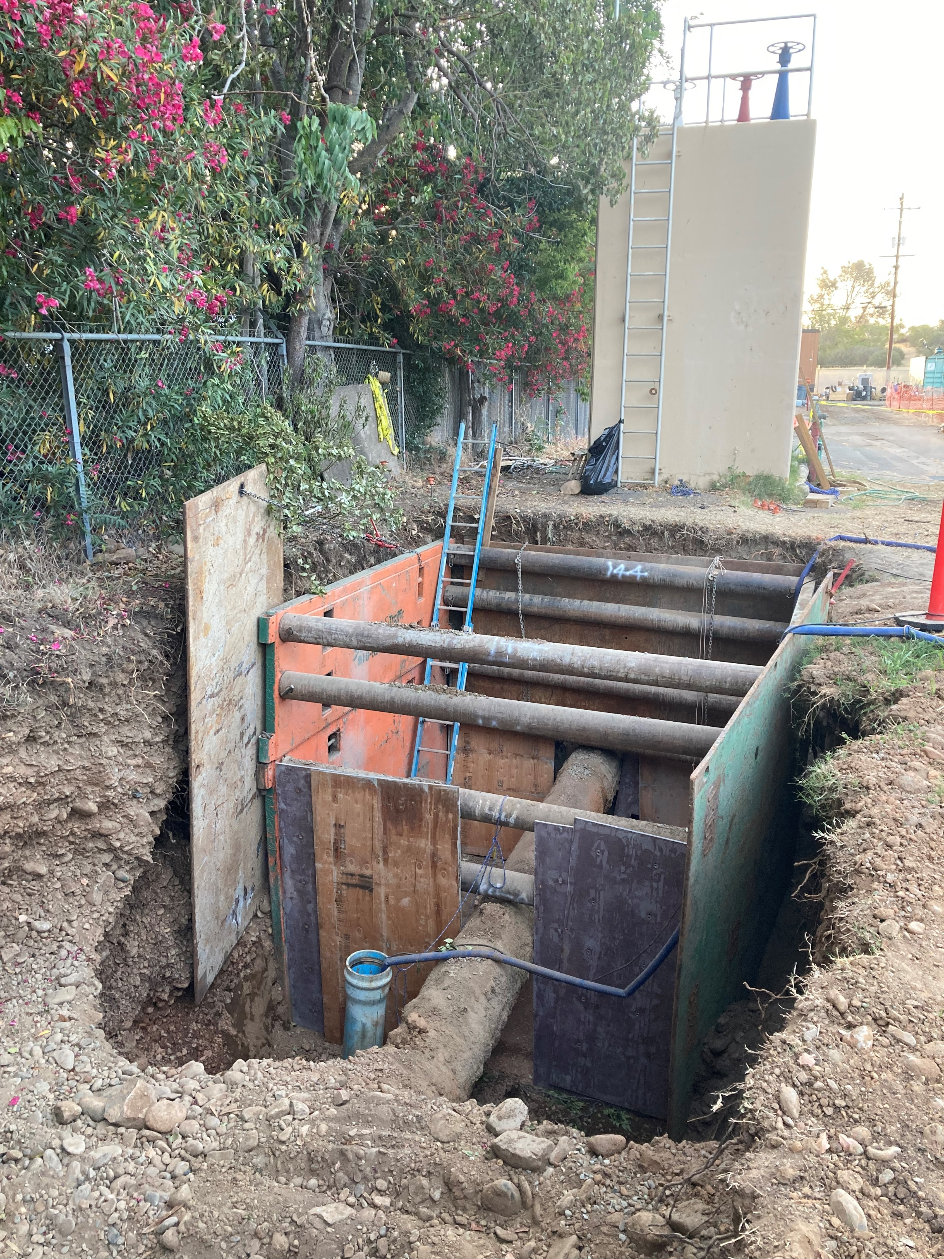
Excavation of The Pond Flow Meter Vault

Slide 6
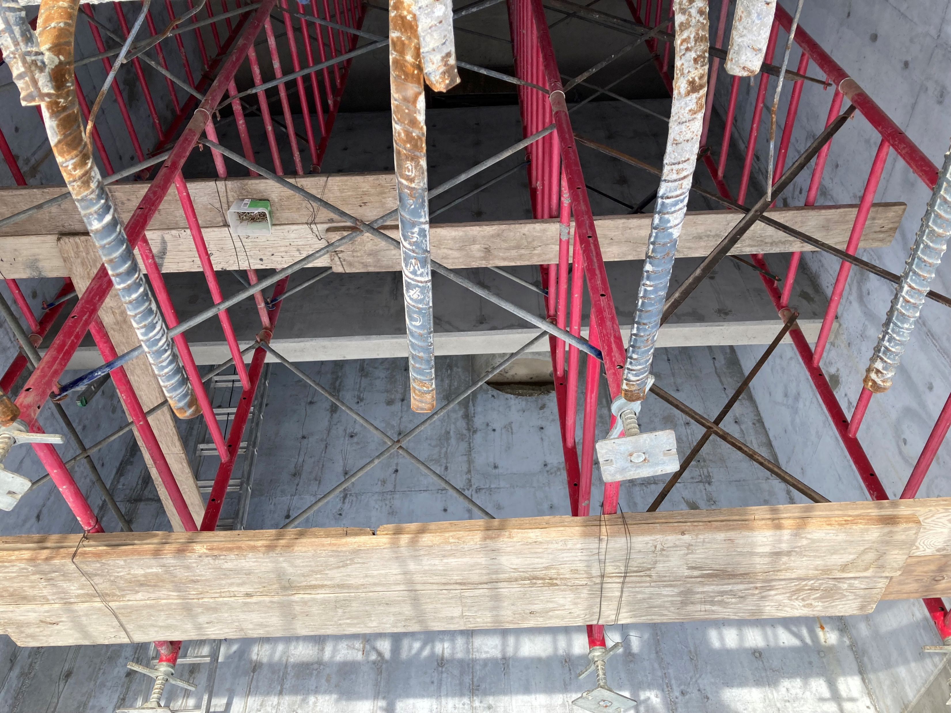
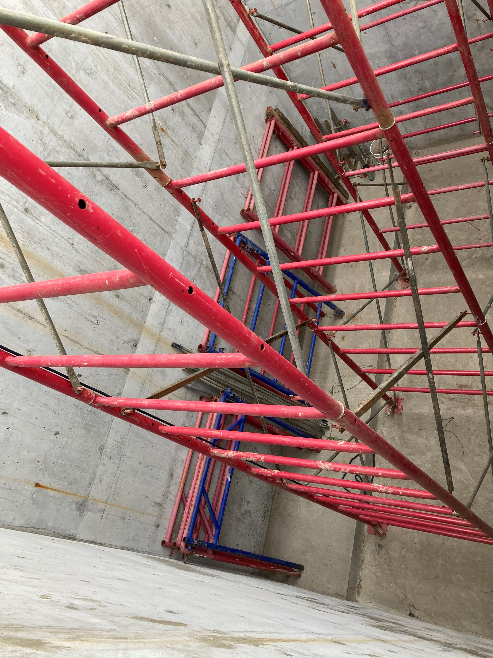
Internal Wall in The Wet Well Complete, Scaffolding Installed to Build Form For The Lid

